Slide 1
Demographic monitoring to detect climate change impacts on threatened populations
Bruce E. Kendall
Elizabeth H. Hiroyasu
Bren School of Environmental Science & Management
University of California, Santa Barbara

Slide 2



Is this species threatened by climate change?
Eureka Valley dune grass
CalPhoto
Notes:
I was recently asked to review a downlisting proposal for a rare desert plant. The threats that had triggered the original US Endangered Species Act listing had been mitigated, but there was new concern that the species might be threatened by climate change. These climate change effects would manifest through long-term trends in vital rates—survival and/or reproduction.
This got me thinking bout how best to monitor a population to detect such effects.
In contrast to the usual monitoring problem of simply determining whether a species is declining or not, a trend in vital rates will lead to a change in the rate of population decline, or a shift from a stable population to a declining one.

Slide 3


Should we monitor abundance or vital rates?
© BrokenSphere / Wikimedia Commons
Notes:
The question is, what should we measure? Conservation monitoring commonly tracks abundance, both because it is the quantity that we most care about and because it’s often straightforward to count individuals in a population.
Vital rate monitoring, in contrast, tends to be more costly and time consuming, as each individual must be measured. Survival monitoring also requires marking each individual and finding it again a year later.
Nevertheless, if there is a trend in a vital rate, there are a couple of reasons why monitoring the vital rate directly might be more powerful than simply monitoring abundance.

Slide 4
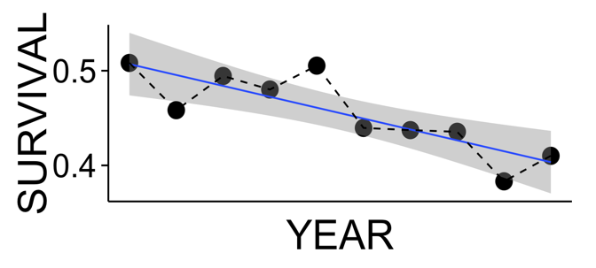
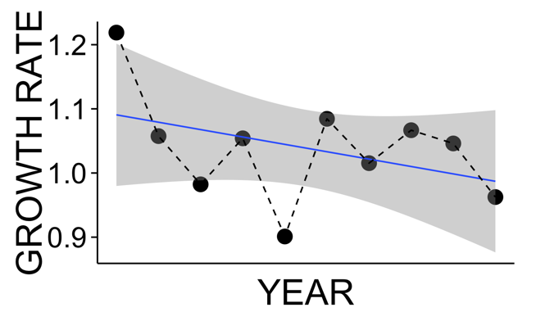
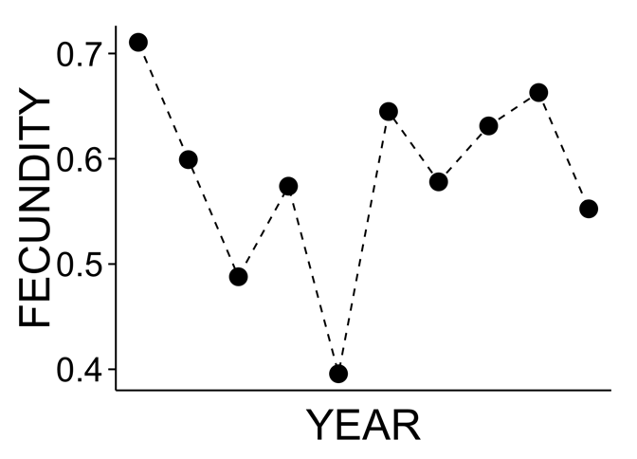
Effect of a vital rate trend can be obscured by variability in another rate
P = 0.003
P = 0.237
Notes:
The first is a swamping effect. Suppose that a population has declining survival through time, with a small P-value providing strong evidence of the decline.
However, the population also has highly variable reproduction from year to year.
When these two vital rates are combined to create the population growth rate, the declining trend is still present, but the P-value is now so large that it is statistically indistinguishable from zero.
I have shown the growth rate here as emerging from the vital rates, but it can be estimated from abundance monitoring, by calculating the difference in abundance from year to year. In fact, for a variety of technical reasons, converting abundance estimates to growth rate estimates is often the best way to analyze abundance trends.

Slide 5
Effects of vital rate trends may be delayed by demographic structure
Notes:
The second complication is that in populations with age or stage structure, the population growth rate is often a nonlinear function of the underlying viral rates. This means that the early phase of a vital rate decline may have relatively little effect on the population growth rate.
This is good news for the population, but it means that abundance monitoring will not detect the worsening conditions for the species, whereas viral rate monitoring may provide an early warning of the forthcoming population decline.

Slide 6
How much more power does vital rate monitoring provide in real species? How much early warning does vital rate monitoring provide?
Notes:
To weigh these effects against the increased cost of vital rate monitoring, we need to quantify both the extra power and the advanced warning provided by vital rate monitoring in real populations.

Slide 7
How much more power does vital rate monitoring provide in real species? How much early warning does vital rate monitoring provide?
Notes:
In today’s talk we focus on power.

Slide 8

We performed a simulation study using “realistic” populations
[2005]
– 0
[2002]
– 0.01
[2001]
– 0.02
[2001]
[2004]
– 0.03
[2002]
Randomize
[2001]
– 0.04
[2003]
[2004]
– 0.05
[2004]
[2004]
Data
– 0.06
[2001]
[2005]
– 0.07
[2004]
– 0.08
Salguero-Gomez et al. (2015)
J. Ecol. 103: 202
www.compadre-db.org
[2003]
– 0.09
Notes:
We used the COMPADRE plant matrix database to examine patterns across a range of plant species. For this talk we focused on populations of herbaceous perennial plants in the database that had at least three stages and at least five years of data.
The data are a sequence of annual demographic matrices containing information on survival and fecundity of each stage.
To simulate environmental variability we randomized the matrices; on average these random sequences have no demographic trends.
We then simulated a vital rate trend by reducing survival by 1 percent each year.

Slide 9
We simulated by iterating the model using matrix multiplication
[N0]
Record vital rates
[N1]=[2005]x[N0]
Record abundance
[N2]=[2002]x[N1]
– 0.01
Calculate growth rate

Slide 10
We estimated trends in both vital rates and population growth rate
“Vital rate monitoring”
P = 0.003
“Abundance monitoring”
P = 0.237
Notes:
For each replicate we used linear regression to estimate the linear trend in observed survival, which I will call “vital rate monitoring”.
We did the same to estimate the linear trend in observed population growth rate, which I will call “abundance monitoring” because growth rate is calculated from the time series of total abundance.
In both cases we recorded the P value as an index of the statistical evidence for the trend—small P-values mean that we are confident that conditions are changing.

Slide 11
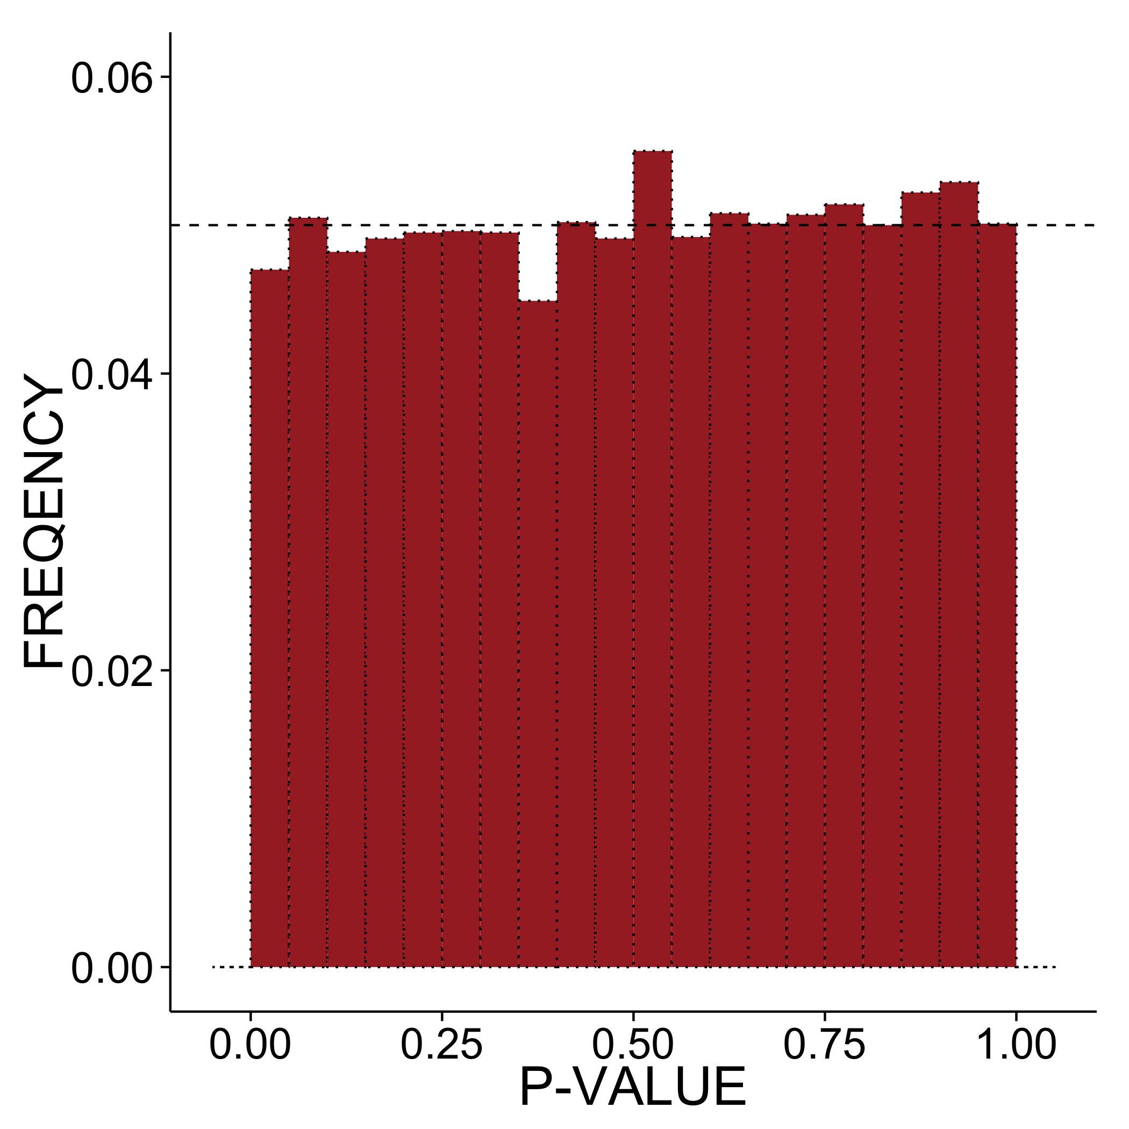
We compare P-value distributions of vital rate & abundance regressions
Notes:
For each population we performed 10,000 simulations, giving us 10,000 pairs of P-values. This graph shows what we would expect to see if there were no trends in the data, with each P value being equally likely. The bins of the histogram have width 0.05, so the null expectation is that each bar should contain 5% of the replicates, as shown by the dashed line.

Slide 12
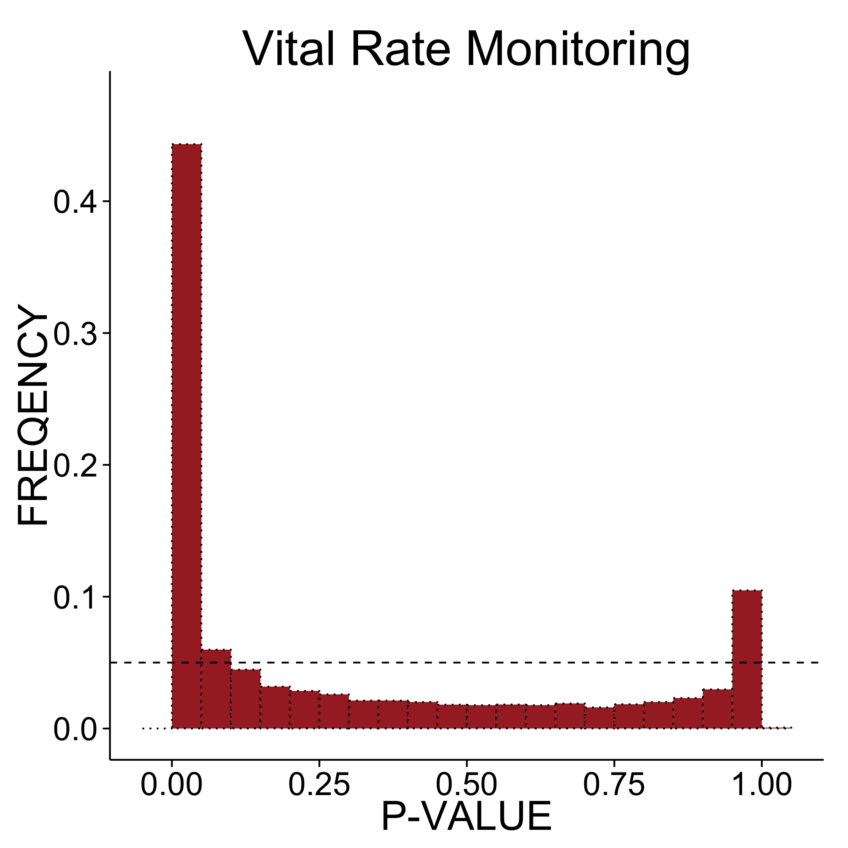
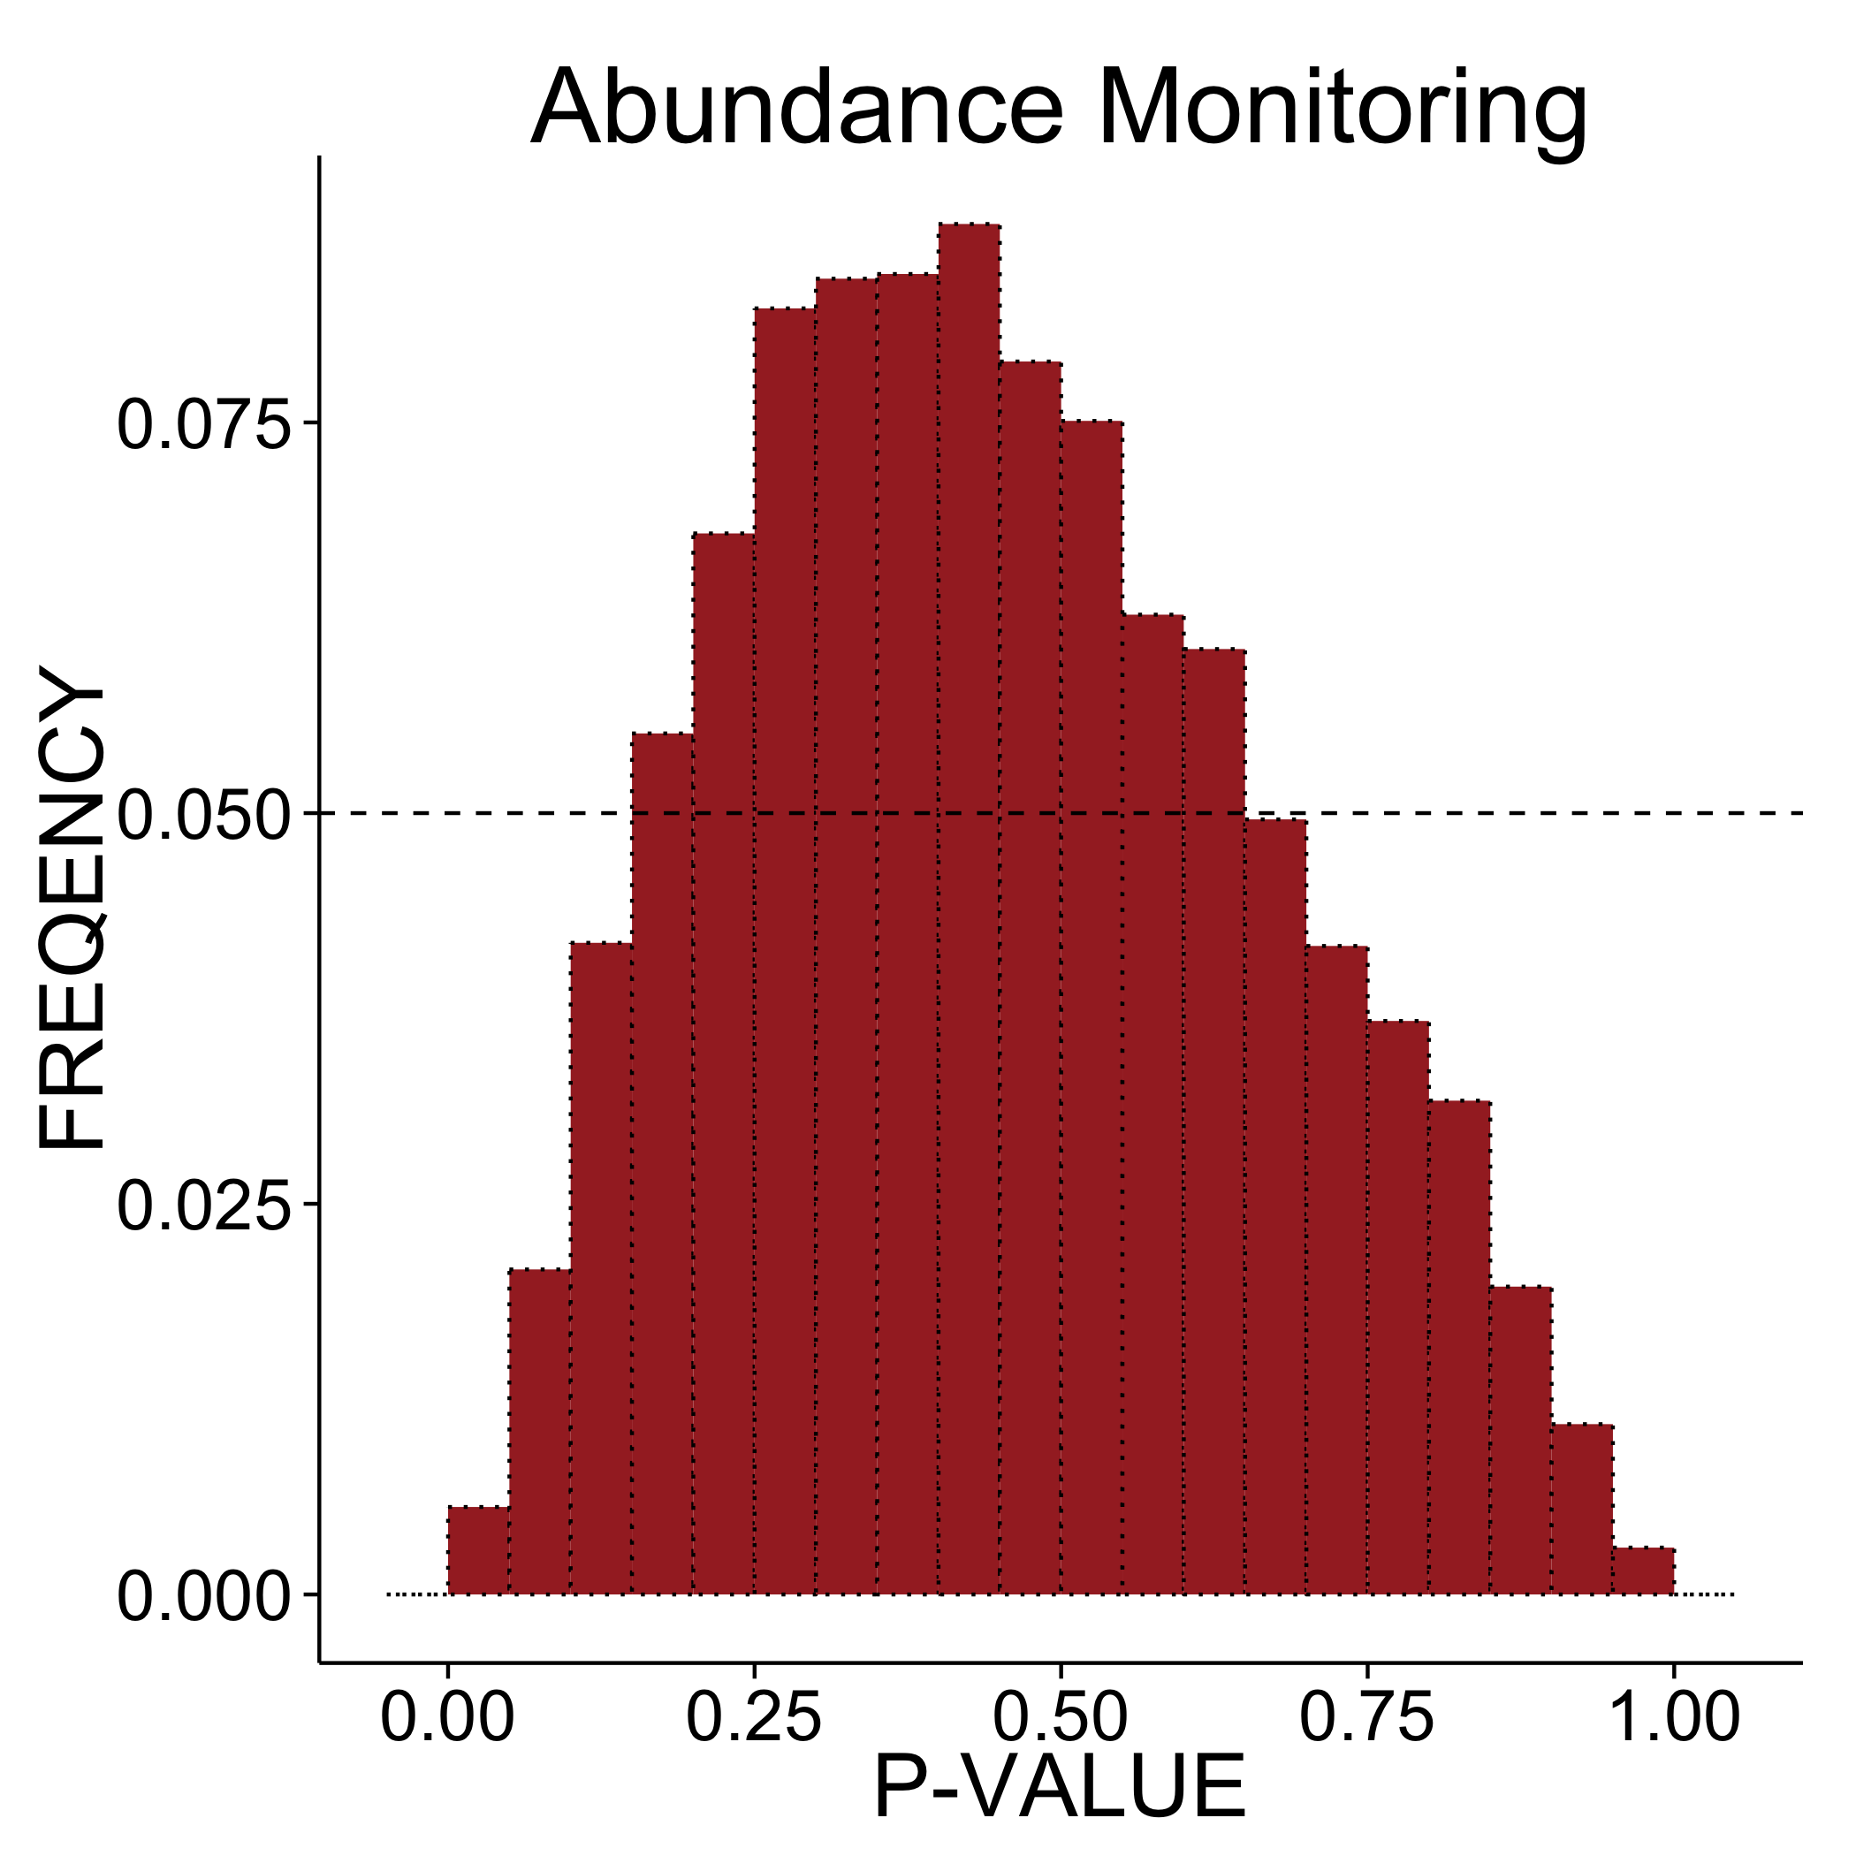
Common result: low vital rate P-values, high abundance P-values
Notes:
Here is the result for one of our populations. Nearly half of the replicates gave a P-value less than 0.05 under demographic monitoring, shown on the left. In contrast, for abundance monitoring the majority of replicates gave a P-value greater than one half.
Thus, given a typical alpha level of 0.05 or 0.1, we would have a good chance of detecting the trend if we were monitoring survival directly, but a very poor chance of detecting the trend if we were simply monitoring abundance.

Slide 13
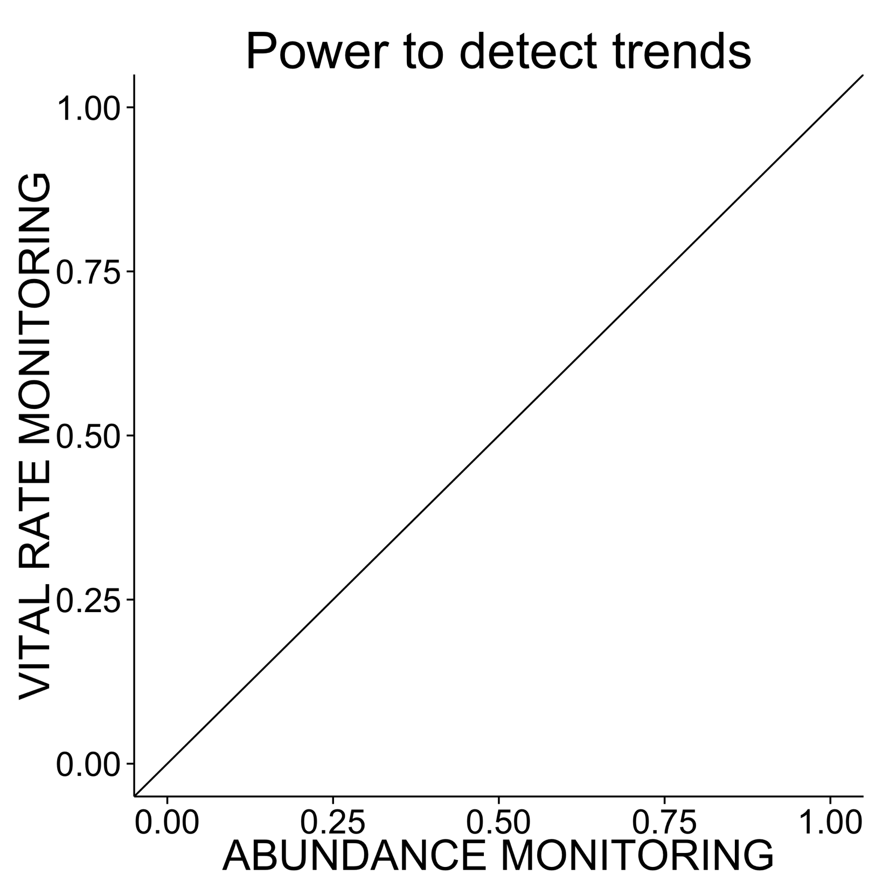
Compare power of vital rate & abundance monitoring
Notes:
I’m now going to show you a synthesis across all 83 populations that we analyzed. For each, we calculated the power at an alpha of 0.1; that is, the fraction of P values that were less than 0.1. The power of abundance monitoring is on the horizontal axis, and the power of demographic monitoring is on the vertical axis. High power is good, so populations for which demographic monitoring is superior will be above the diagonal line.

Slide 14
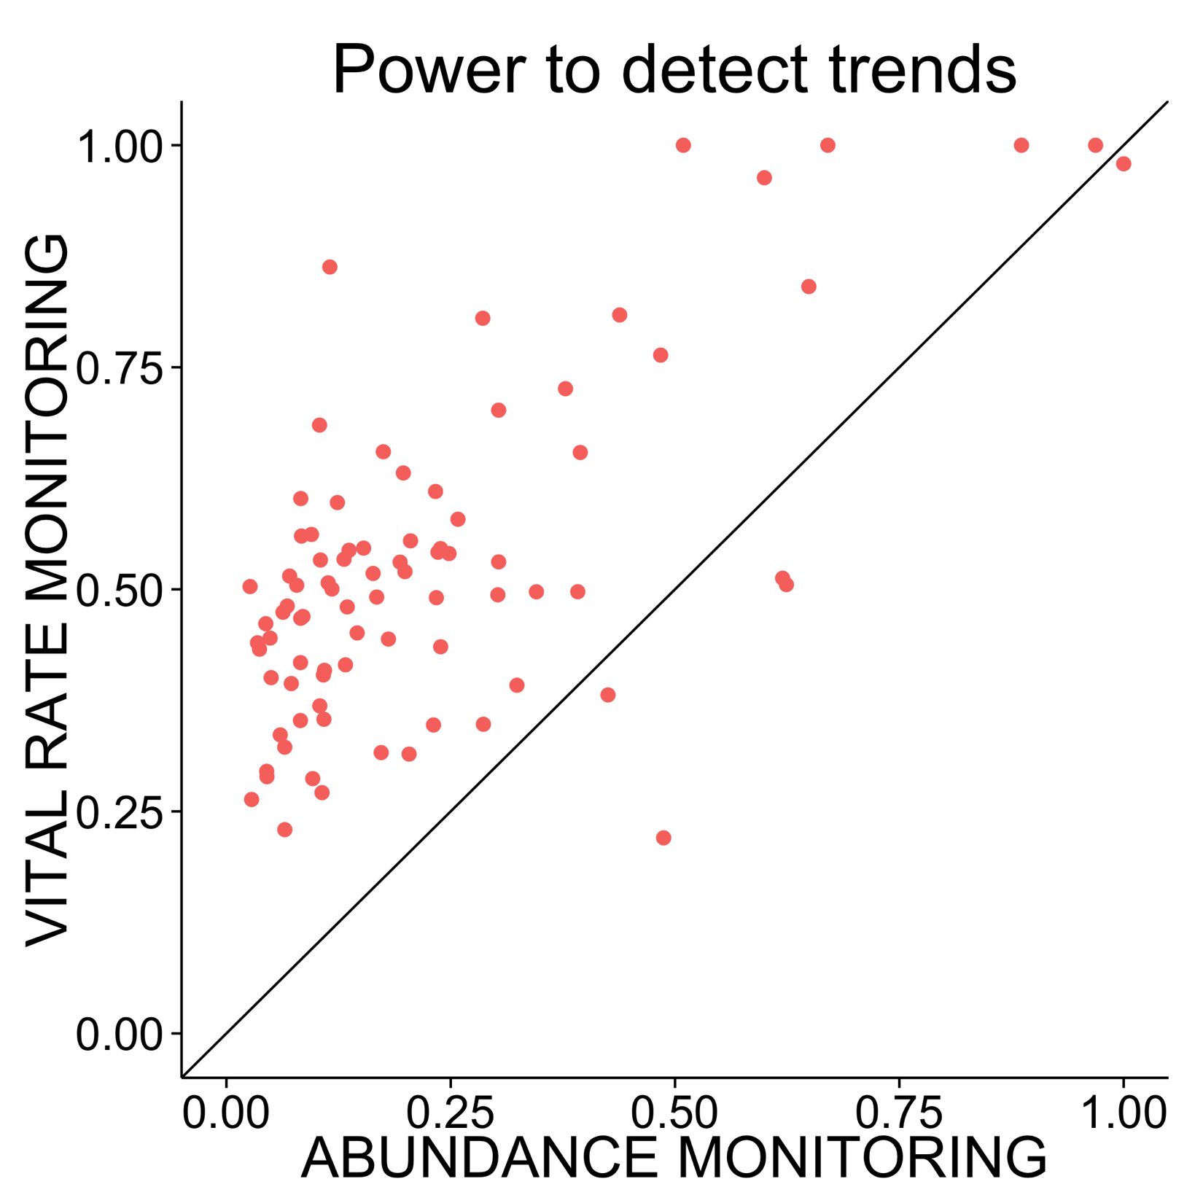
Vital rate monitoring usually has higher power
Notes:
Each of these points is a population; 83 populations from 38 species are represented.
Overall, 95% of the populations had more power to detect the trend under demographic monitoring than under abundance monitoring. The power of viral rate monitoring was usually above 25%, whereas the power of abundance monitoring was usually below 25%
These results indicate that demographic monitoring may be worthwhile across a large range of plant species. However, …

Slide 15
Vital rate monitoring usually has higher power, but we still need to consider…
Measurement effort
Measurement error
What predicts amount of benefit
Notes:
We still need to explicitly account for the higher costs of demographic monitoring.
Furthermore, in our analyses so far we have assumed that both annual survival and annual abundance were measured perfectly. Real world measurement error will reduce the power of both approaches, and the returns to additional sampling effort may be very different for the two monitoring programs.
Finally, we see substantial variation among species and populations in the relative power of demographic and abundance monitoring. To be truly useful for conservation monitoring, we need to know the characteristics of populations that will benefit most from demographic monitoring.
These are all topics of ongoing research, and their resolution should provide a clear picture of when to use demographic monitoring to track climate change impacts on rare species.

Slide 16

Thank you!
Helpful people
Gordon Fox
Jonathan Levine
ETH Plant Ecology Lab
Funding agencies
NSF
UCSB
Notes:
Thank you very much, and I’ll be happy to take any questions!

